Slide 1
Department Improvement Plan (DIP) FY23 Pilot Program

Slide 2
May - June, 2023
June - July, 2023
March 27, 2023 – April 10, 2023
Results/debrief with Executive Leadership, VC, Department Chairs with Action Plan Development.
Results/debrief with Leaders/Managers with Action Plan Development.
July, 2023
Results/debrief rollout to Employees with Action Plan Development.
SURVEY OPENS
Notes:
To help achieve our Vision 2029 goal of being in the 46th percentile engagement score by 2025, the pulse survey is specifically targeted towards teams that scored in the lower quartile. It provides an opportunity to identify areas for improvement and take action towards enhancing employee engagement. Please note that only employees hired prior to December 25, 2022, will receive the survey.

Slide 3
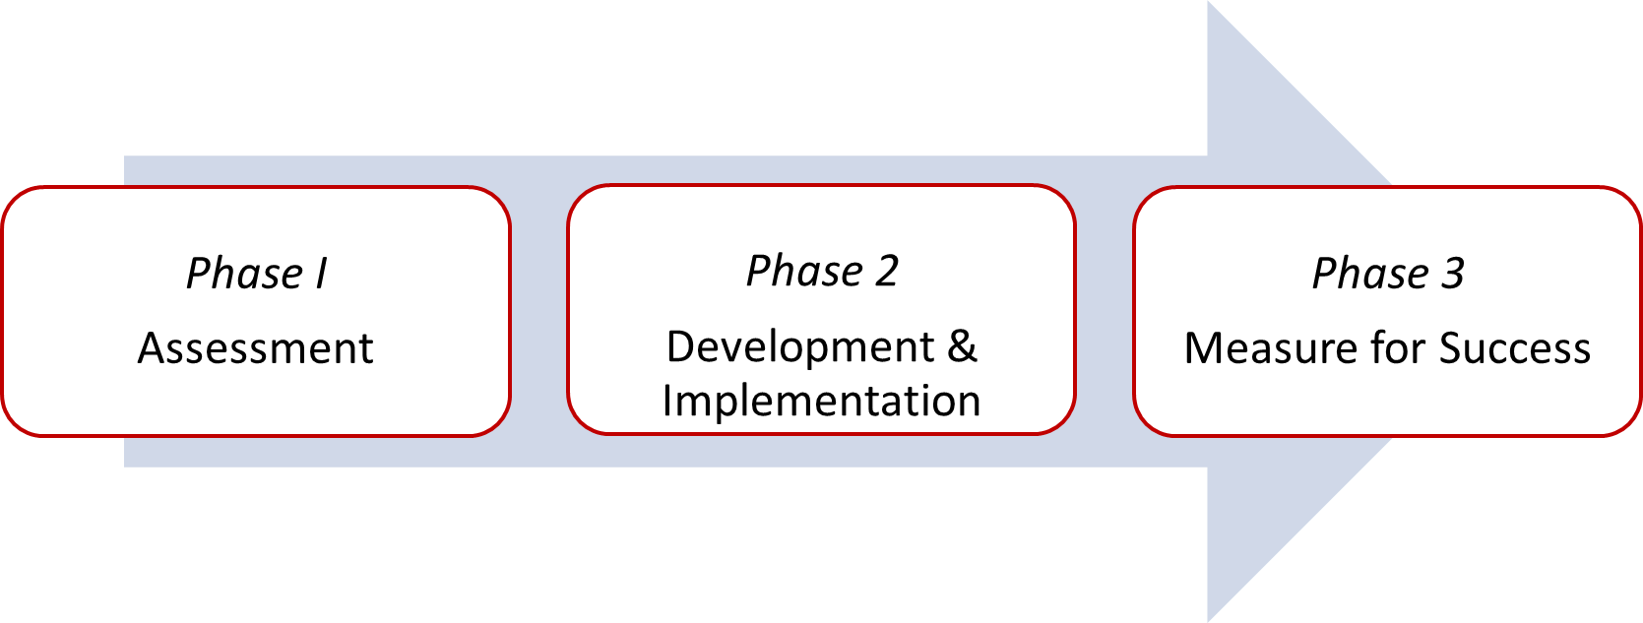
Overview
Department Improvement Plan (DIP) is designed as a three-phase program over a 6-month period that will provide leaders with the resources needed to increase employee engagement.

Slide 4
The People & Culture Partner team will make the following commitments to department leadership during this 6-month journey:
PHASE I
PHASE II
PHASE III
Facilitate a team presentation and review your Department Needs Assessment. Collaborate with department leaders to develop an action plan for enhancing leadership competencies, intradepartmental communication, and change management.
Partner and collaborate to develop a strategic road map with the emphasis on improving employee well-being, recognition, and culture as outlined by Organizational Leadership.
Continued support with collaborative follow-up, additional surveys, and guidance on obtaining action plan deliverables.
Notes:
The Chancellor challenged all teams to create Action items across UAMS were developed to tackle these issues (at a minimum) .
Develop one action item that focuses on employee well-being
Develop one action item focused on improving recognition
Develop one action item focused on improving the culture within your team(s).

Slide 5
Phase I – Assessment (May – June)
Assessment
360 Leadership Assessment
Collecting Retention Data
Conversation with Division Leader
Preparation for Team Assessment Presentation
Notes:
Assessment – focus on the 2 manager questions from Pulse Survey (obtain Division Leader support)
360 Leadership Assessment – Feedback from direct reports, peers, and one level up. PCP Team will develop questionnaire.
Collecting retention data – People Element Exit Survey data (if available), focus on job titles within dept. with high turnover, termination reports (review of involuntary and voluntary separations), and using NSI data/UAMS mean as benchmark
Conversation with Division Leader – review information found from previous step
Preparation for Team Assessment Presentation – overview of all information gathered (EE Engagement Survey, Pulse Survey, retention data, etc.)

Slide 6
Phase 2 – Development and Implementation (July 2023)
Team Assessment Presentation
Department Needs Assessment Form
Create or Revise Gallup Action Plan
Leadership Action Plan Presentation to Employees
Notes:
Team Assessment Presentation – PCP will prepare and facilitate presentation (partnership between PCP and department leader)
PCP – Department Needs Assessment Form – manager to complete based on findings and team feedback
Create or Revise Action Plan – Manager to complete this task using Gallup action plan template. The expectation is to set action items to improvement engagement.
Manager Action Plan Presentation to employees – PCP will assist with the preparation and provide template format

Slide 7
Phase 3 – Measure for Success
6 Week Progress Check-In
(September 15th)
12 Week Progress Check-In
Revise Action Plan (if needed)
Action Plan Deliverables
2nd Pulse Survey (September 15th – 30th)
Notes:
2nd Pulse Survey – If available, we will create same Pulse Survey Gallup to determine if engagement has improved
12 Week Progress Check – In = Review 2nd Pulse Survey Data and update action plan (if needed)

Slide 8
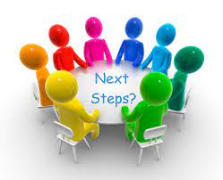
Please consult with your People & Culture Partner (PCP) for next steps.

